Slide 1
ONE INNOVATION HUB AI CLASS
ENSEMBLE METHODS

Slide 2
INTRODUCTION
Ensemble methods are general principles and techniques for combining several predictors/models to create and achieve a more accurate one.
It creates multiple models and then combine them to produce improved results.
This algorithm has shown to be very effective in practice and more accurate than most other single models.

Slide 3
The models that contribute to the ensemble prediction are usually termed as ensemble members.
These members may be the same models or different ones and may or may not be trained on the same training data.
These prediction made by these ensemble member models are then combined together through several methods

Slide 4
TERMINOLOGIES IN ENSEMBLE METHODS
VOTING: This is usually used for Classification Problem. It is used to chose the best predicted value for a combination of ensemble models.
TYPES OF VOTING
Majority
Weighted

Slide 5
AVERAGING
This is similar to voting except that it is used for regression problems
TYPES OF AVERAGING
Simple averaging
Weighted averaging

Slide 6
ENSEMBLE METHODS
BAGGING: This is one of the way of manipulating the training dataset. It is also called BOOTSTRAP AGGREGATION
Bagging presents the learning algorithm with a training set that consists of a sample of ‘m’ training examples drawn randomly with replacement from the original training set of ‘m’ items
Each bootstrap replicate contains about 60% of the original training data with several training examples appearing multiple times

Slide 7
STEPS IN BAGGING
Step 1: Create multiple model, remember that, model = algorithm + dataset
Step 2: These models must be created using the same algorithms e.g LASSO regression or linear regression
Step 3: The algorithm will be trained with random sub-samples of the dataset which are from the original dataset. This is to be done using a bootstrap sampling method.

Slide 8
The technique of bootstrap sampling is that, in the random sub-sample that is fed to the algorithm, some of the original data appear more than once and some original data do not appear at all.
This then continues for all the different algorithms.
For each bootstrapped set, the number of elements selected is the same as the original training dataset, but elements are chosen randomly with replacement.

Slide 9
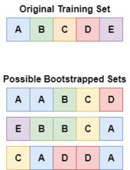
Step 4: All the generated models will then be aggregated together using methods such as voting and averaging

Slide 10
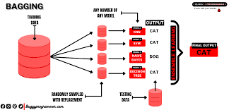

Slide 11
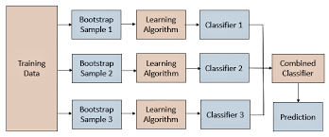

Slide 12
Examples of algorithm that uses bagging methods includes
Bagged Decision Trees
Random Subspaces
Random Forest
Extra Trees
Custom Bagging

Slide 13
BOOSTING
These ensembles involve adding models sequentially to correct the predictions of prior models.
Boosting involves incrementally building an ensemble by training each new model instance to emphasize the training instances that previous models mis-classified.
This is a method of rapidly reducing the empirical error as a function of the number of rounds of boosting.

Slide 14
Boosting makes use of algorithms that are able to convert weak models to strong models.
A model is termed as weak if it has a substantial error rate of 0.5 for binary classification.

Slide 15
HOW DOES BOOSTING WORKS?
In Boosting, an equal weight is given to the sample training data (say D1) at the very starting round.
This data (D1) is then given to a base algorithm (say L1).
The mis-classified instances by L1 are assigned a weight higher than the correctly classified instances, but keeping in mind that the total probability distribution will be equal to 1.
This boosted data (say D2) is then given to second base learner (say L2) and so on.
Result are then compiled based on voting.

Slide 16
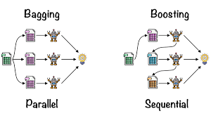
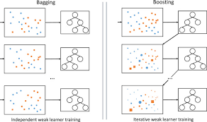

Slide 17
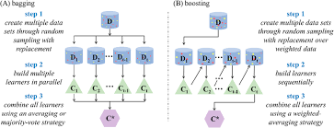

Slide 18
These ensembles involve adding models sequentially to correct the predictions of prior models.
Some algorithms include:
AdaBoost
Gradient Boosting Machine
Stochastic Gradient Boosting
XGBoost
LightGBM

Slide 19
STACKED GENERALIZATION
This is also referred to as STACKING. It is an ensemble method in which the predictions from a model are combined using another algorithm to then make a final prediction.
The basic idea is to train machine learning algorithms with training dataset and then generate a new dataset with these models. Then this new dataset is used as input for the combiner machine learning algorithm

Slide 20
These ensembles involve using a model to learn how to best combine the predictions from models.
Some algorithms include:
Voting
Weighted Average
Blending
Stacking
Super Learner

Slide 21
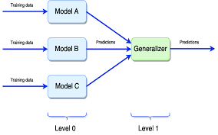
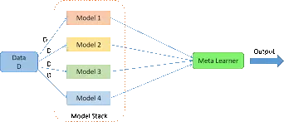

Slide 22
REFERENCES
Dieterrich G.T (2022), Ensemble Methods in Machine Learning https://web.engr.oregonstate.edu/~tgd/publications/mcs-ensembles.pdf
Brownlee J. (October 26, 2020). Why Use Ensemble in Machine Learning https://machinelearningmastery.com/why-use-ensemble-learning/
Demir N (2016). Ensemble Methods: Elegant Techniques to Produce Improved Machine Learning Results https://www.toptal.com/machine-learning/ensemble-methods-machine-learning

